Slide 1
Introduction to Quantum Computing: From a Layperson to a Programmer in 30 Steps
Hiu-Yung Wong
https://link.springer.com/book/10.1007/978-3-030-98339-0
https://www.amazon.com/Introduction-Quantum-Computing-Layperson-Programmer/dp/3030983382
Playlist: https://www.youtube.com/watch?v=cx3HLmyxBGs&list=PLnK6MrIqGXsJfcBdppW3CKJ858zR8P4eP&index=14
https://www.youtube.com/watch?v=85SoQ5f5dHk&list=PLnK6MrIqGXsJfcBdppW3CKJ858zR8P4eP&index=15
https://www.youtube.com/watch?v=bFIt_b8b4jc&list=PLnK6MrIqGXsJfcBdppW3CKJ858zR8P4eP&index=16
https://www.youtube.com/watch?v=CX71PJ8Bd2M&list=PLnK6MrIqGXsJfcBdppW3CKJ858zR8P4eP&index=17

Slide 2

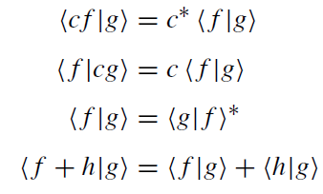
Hilbert Space
Any pair of vectors, If> and |g>, and for any complex number, c, with the following properties
Any Finite dimensional vector space with inner product is a Hilbert Space

Slide 3
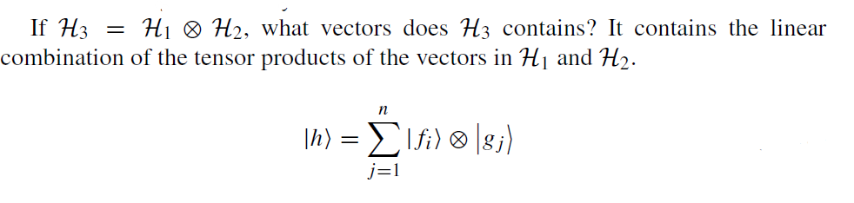
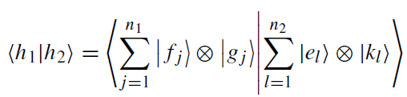


Tensor Product of Hilbert Space
3)
4)
1)
5)
1)
2)

Slide 4
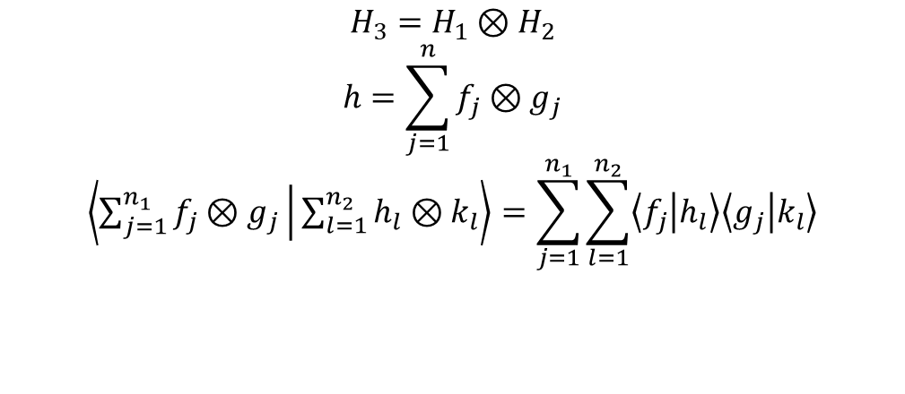
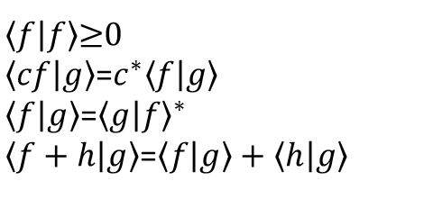
Summary
Hilbert Space (Physics convention)
A complete linear space with inner product obey:
$\left\langle f | f\right\rangle$≥0
$\left\langle cf | g\right\rangle$=$c^{∗}\left\langle f | g\right\rangle$
$\left\langle f | g\right\rangle$=${\left\langle g | f\right\rangle }^{∗}$
$\left\langle f+h | g\right\rangle$=$\left\langle f | g\right\rangle +\left\langle h | g\right\rangle$
Tensor Product of Hilbert Spaces
$$H_{3}=H_{1}⊗H_{2}$$
$$h=\sum_{j=1}^{n}{f_{j}⊗g_{j}}$$
$$\left\langle \sum_{j=1}^{n_{1}}{f_{j}⊗g_{j}} | \sum_{l=1}^{n_{2}}{h_{l}⊗k_{l}}\right\rangle =\sum_{j=1}^{n_{1}}{\sum_{l=1}^{n_{2}}{\left\langle f_{j} | h_{l}\right\rangle \left\langle g_{j} | k_{l}\right\rangle }}$$
Any finite sum

Slide 5


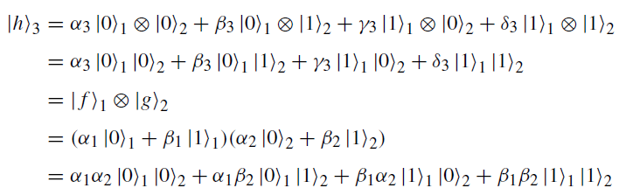
Tensor Product of Qubit
1 Qubit Vector
2 Qubit Vector

Slide 6
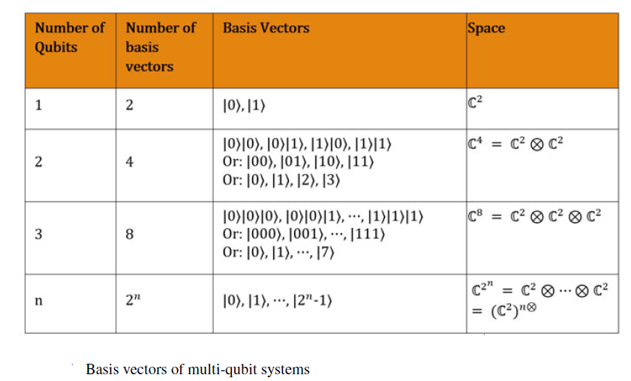
Tensor Product of Qubit

Slide 7
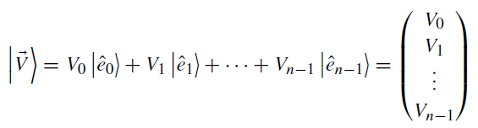
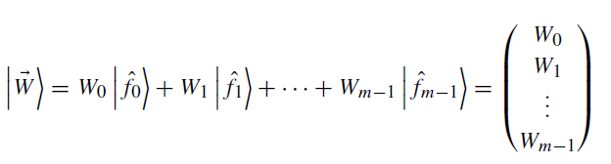
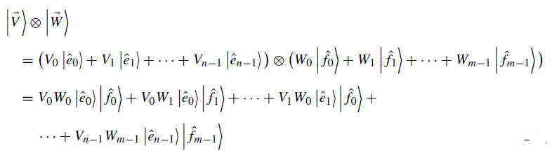
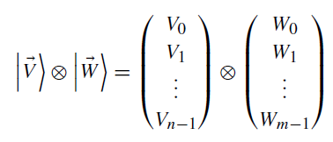
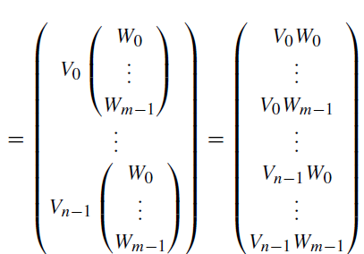
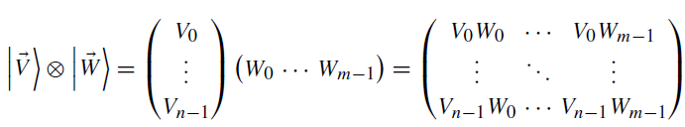
Tensor Product Example (1)

Slide 8

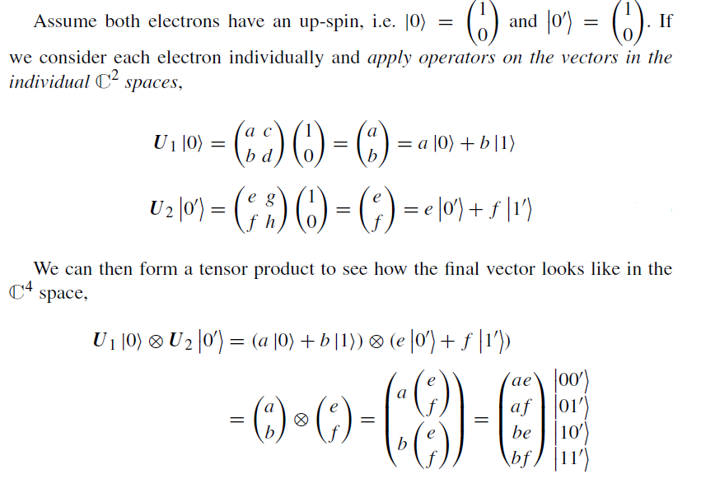
Example on Tensor Product (2)

Slide 9
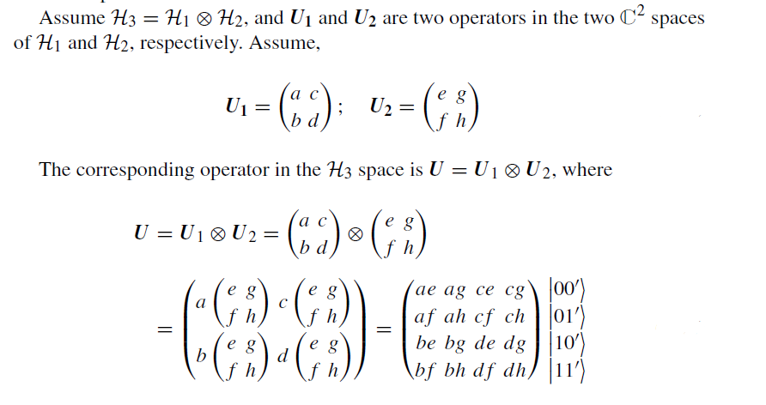
Matrix in Tensor Product

Slide 10
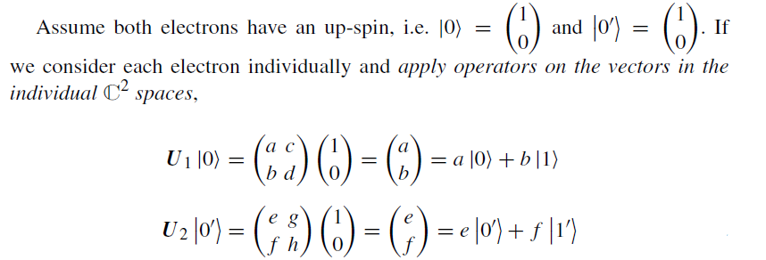
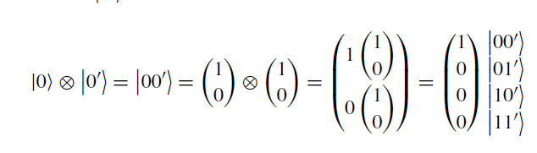
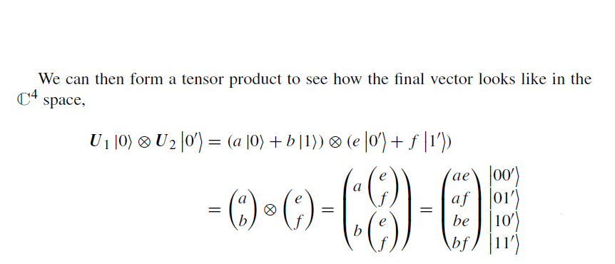
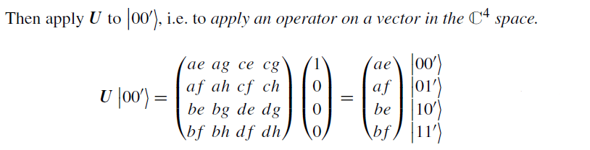
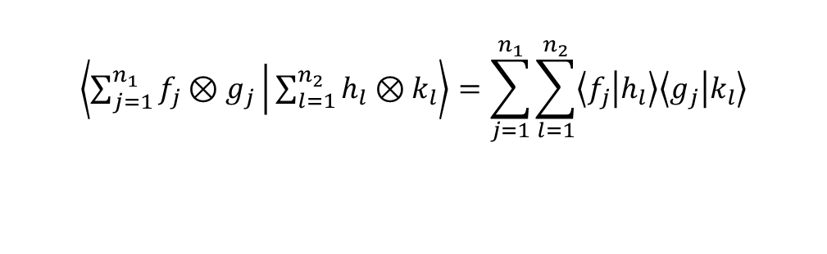
Example of Matrix Tensor Product
$$\left\langle \sum_{j=1}^{n_{1}}{f_{j}⊗g_{j}} | \sum_{l=1}^{n_{2}}{h_{l}⊗k_{l}}\right\rangle =\sum_{j=1}^{n_{1}}{\sum_{l=1}^{n_{2}}{\left\langle f_{j} | h_{l}\right\rangle \left\langle g_{j} | k_{l}\right\rangle }}$$

Slide 11






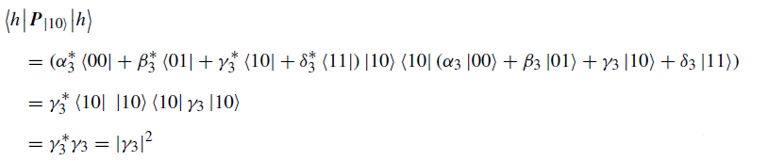
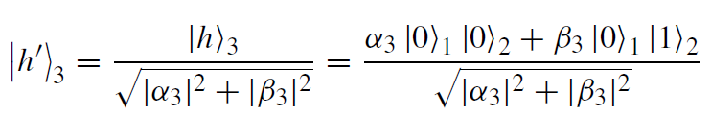

Partial Measurement
Single Qubit
2nd Qubit

